Slide 1
Warren T Jackson 2019 District Technology & Innovation Competition Winners

Slide 2
Productivity Design (5th & 6th)
1st: Bryce Ebersole & Nate Newsome

Slide 3
Robotics (5th & 6th)
2nd Place: Hugh Carter & Jatin Bottu

Slide 4
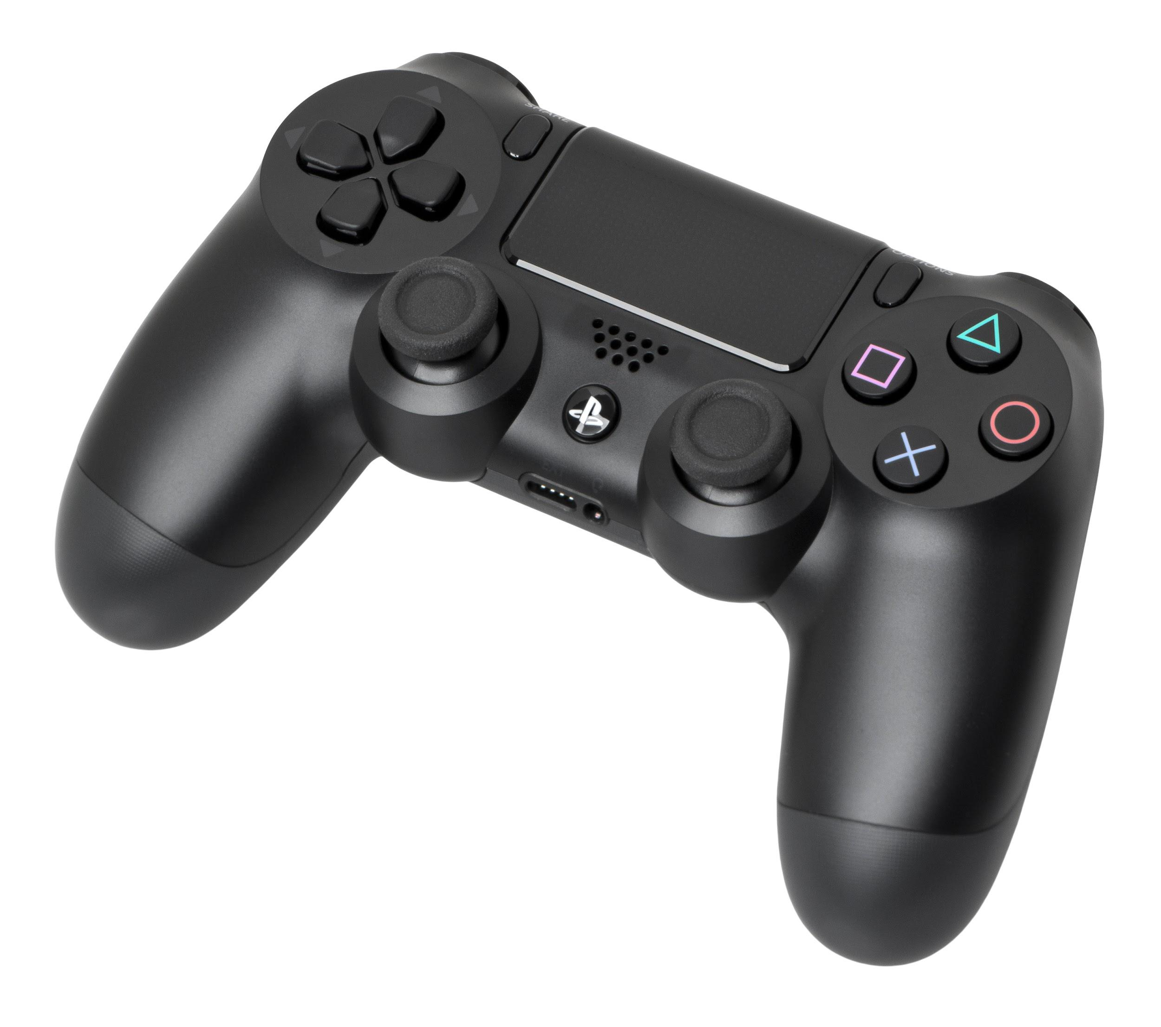
Digital Game Design(3rd & 4th)
1st Place: Bruno Fleury & George Wirth
3rd Place: Brooks Fiftal & Yusuf Saadi

Slide 5
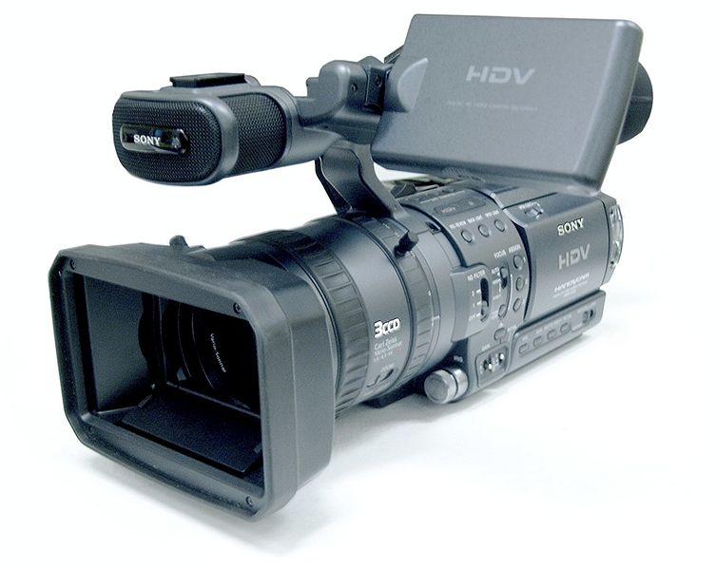
Video Production (3rd & 4th)
1st Place: Jonas Hausner

Slide 6
Internet Applications (3rd & 4th)
3rd Place: Louise Abercrombie & Harper Rodgers

Slide 7
Device Modification (3rd & 4th)
1st Place: Chloe Riker
2nd Place: Nick Stoll & Luca D’Amico

Slide 8
Multimedia Application (3rd & 4th)
1st Place: Lauren Ballinger & Cathryn-Rose Kolb

